Slide 1
How to use the Champion Presentation
Remember to hide or delete this slide before you present
This is intended to be a very high-level presentation that could be delivered in as little as 15 minutes.
Our suggested speaking remarks are in the “notes”.
There are many opportunities to tailor this presentation to suit your needs:
  Add your company logo in placeholders on slide 1
  Add your company’s 2025 fundraising results, logo and a team photo to slide 5
  Customize slide 7 & 8 to communicate your goal(s) and campaign initiatives
  Invite a guest speaker: United Way Philanthropy Officer, Sponsored Employee (5 min.) or agency impact speaker (book through United Way Elgin Middlesex)
  Slide 10 feel free to update with a QR Code to your custom UW workplace giving page
  We ask that you do not modify the United Way branding or logos.
Additional content can be found in the 2025 Campaign Key messages & playbook, accessible in the online Toolkit

Slide 2
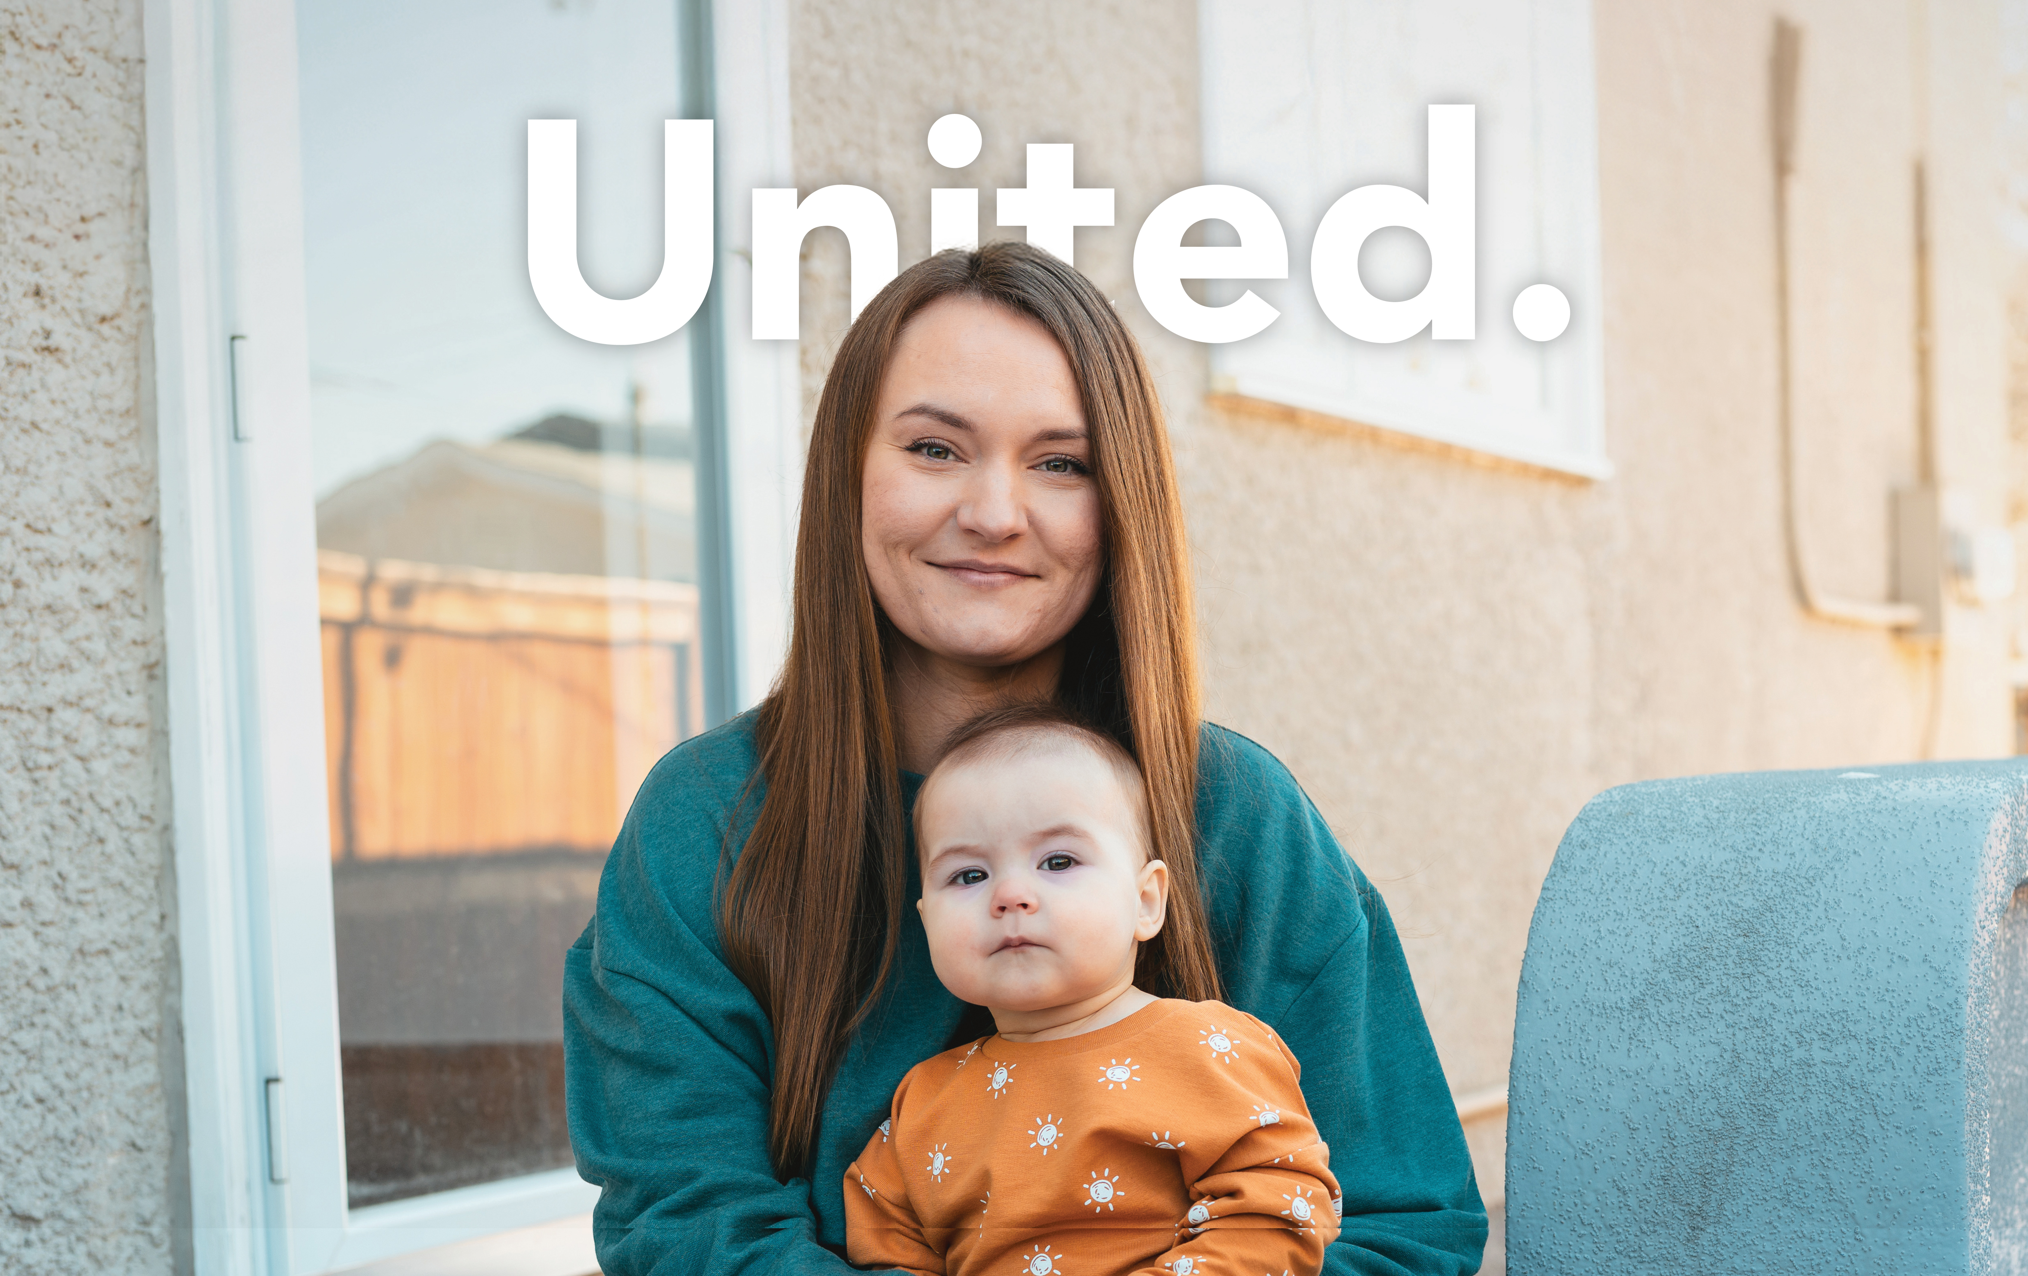

[Insert your company logo here]
WORKING WITH LONDON,
ST. THOMAS AND COMMUNITIES
IN ELGIN & MIDDLESEX
Notes:
If in person: It's great to have you all here for our 2025 United Way Community Campaign! Thank you for your time today.
[Insert your own welcome to group, specific people in attendance & any people to introduce]
I am here to talk briefly about what it means to be United.
United to tackle poverty.
United for housing stability, essential needs mental health supports. For neighbours, friends, and family.
United for hope.
United for a community where everyone matters.

Slide 3
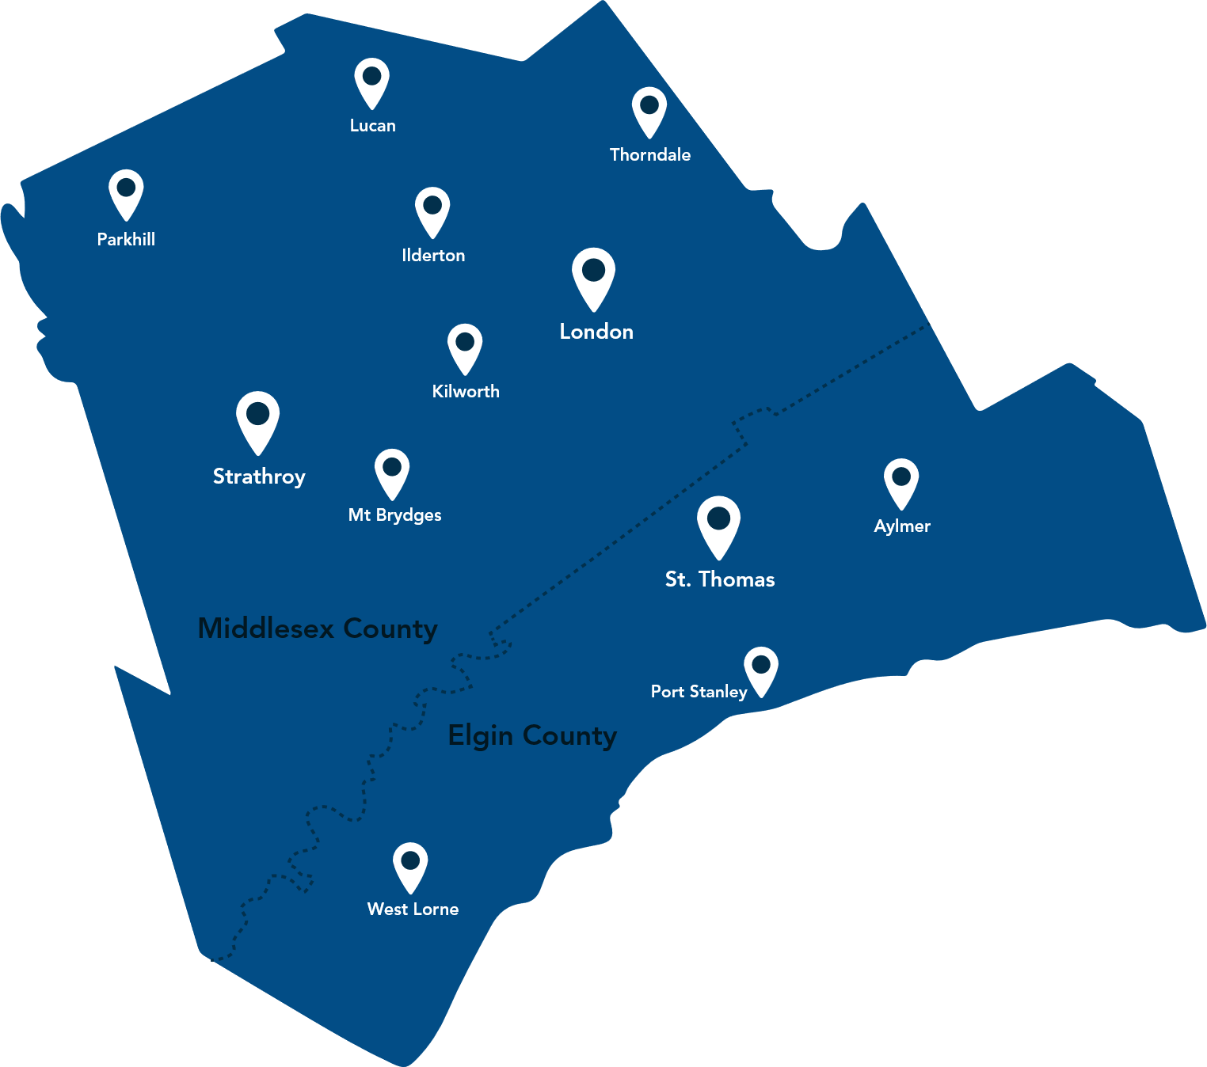

Tackling poverty
so that everyone
has a fair shot
at a good life
UNITED WAY 2025 COMMUNITY CAMPAIGN
Notes:
Core Messages
United Way Elgin Middlesex tackles poverty to give everyone a fair shot at a good life.
They prioritize housing stability, essential needs, and mental health supports.
These issues are all connected to each other, and all connected to poverty. To make the greatest impact, United Way supports local programs and public policies that focus on the individuals and communities who are most impacted.
United Way is more than a funder, they advocate on issues that matter to you and your neighbours, and they mobilize community partners to do the most good for families, children, seniors, neighbours and friends.
3

Slide 4
The need
Our Impact
1 in 5 children in our region are living in poverty
As of June, there are at least 1,987 individuals experiencing homelessness in London
There are 7,628 families on the waitlist for affordable housing
We helped over 112,000 people this year
We invest over $5 Million dollars every year, including funds for programs at 39 local agencies
UNITED WAY 2025 COMMUNITY CAMPAIGN
Notes:
Along with inflation, over the past few years food costs have increased by 24%.
This means families are spending more money to buy less. And rising housing costs make the situation even more dire – for example rental prices have reached increased over 15% in just one year.
For many families, creates an impossible choice: pay the rent or put food on the table.
Nearly 40% of Canadians are now cutting back on groceries to afford other bills.
This economic stress is also taking a toll on mental health. People concerned about losing their homes are three times more likely to experience severe anxiety and depression.
The proportion of Canadians reporting difficulty meeting their financial needs has nearly doubled over the last two years to 33%.
That's why United Way is so important.
4

Slide 5
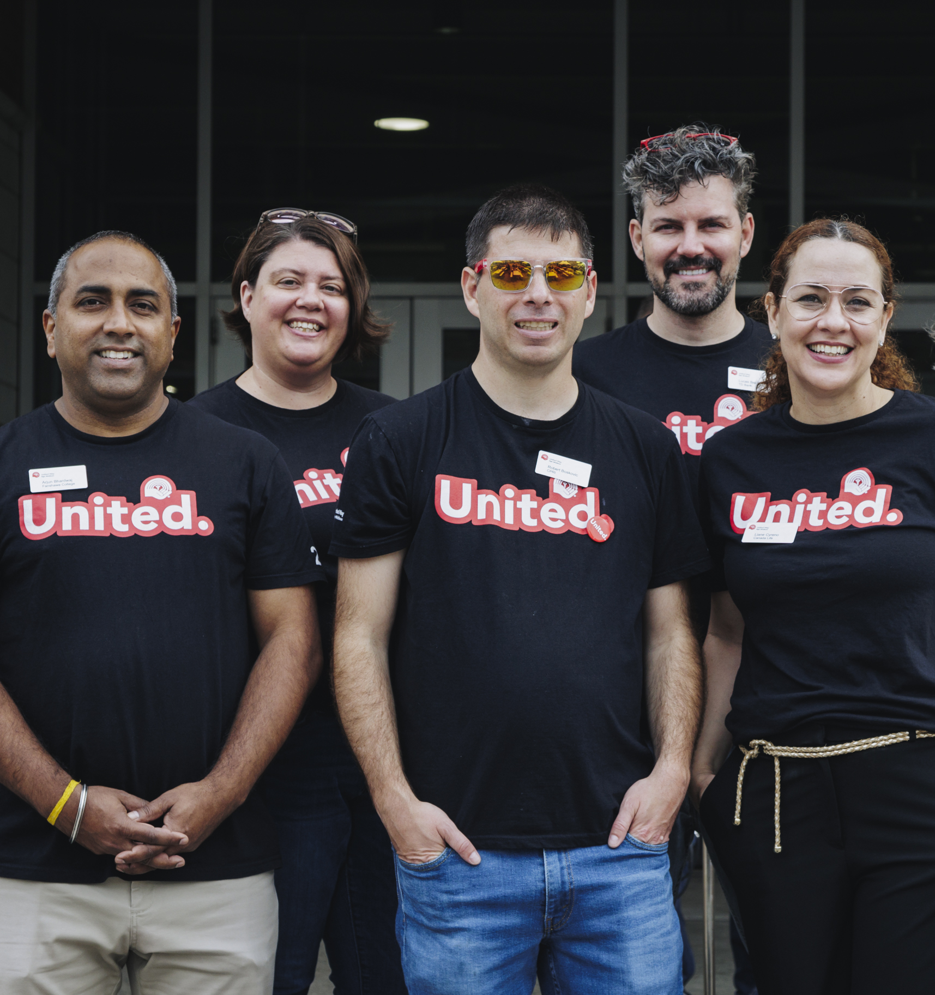
[Insert your company logo here]
Last year
We raised
$xx,xxx
UNITED WAY 2025 COMMUNITY CAMPAIGN
Notes:
Last year, our [company name] campaign raised $xx,xxx in support of United Way Elgin Middlesex!
Thank you for participating in [list the various ways that your campaign raised funds - payroll giving, internal fundraising events, United Way events, etc.].
We have been supporting United Way for [X years] and in that time we've raised [Lifetime $amt]!
5

Slide 6
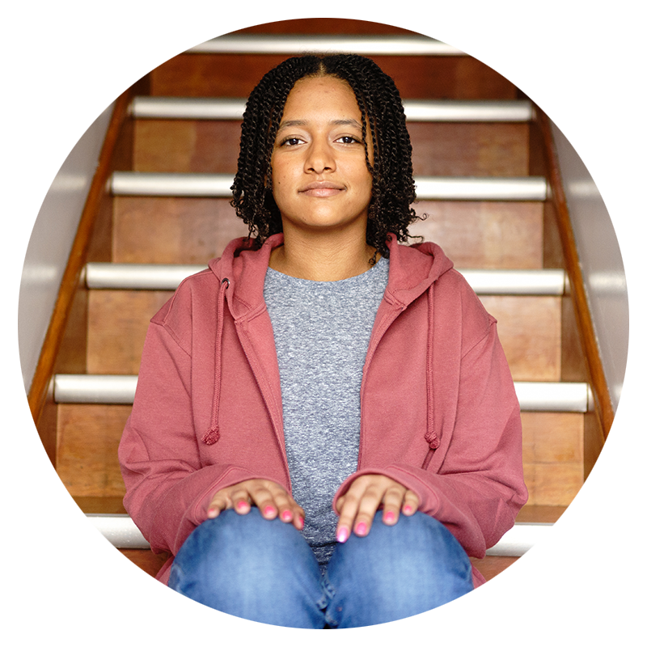

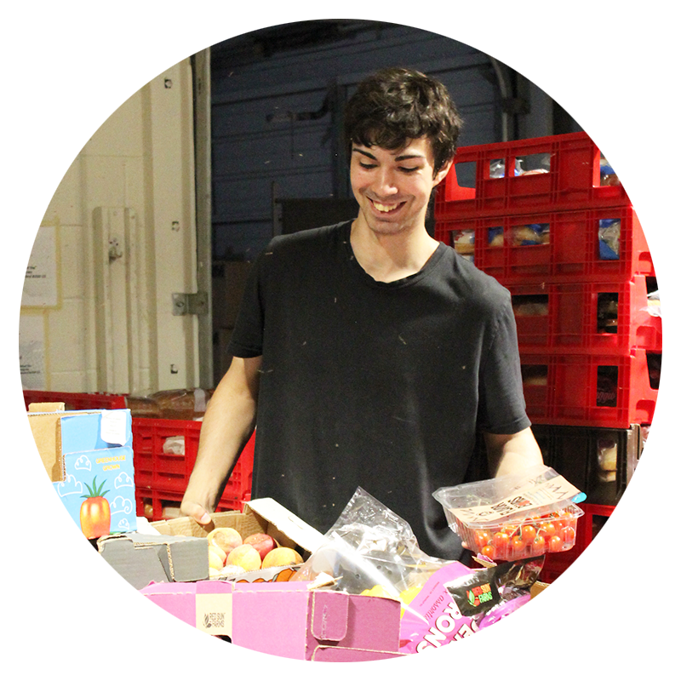

Everyday Hero
$1/day
Provides 30 nights of
supportive housing for someone
at risk of homelessness
Friend
$5 / pay
Provides supplies for 10 kids
in the "GoGirls" program at
Big Brothers / Big Sisters
Leader
$100 / month
Supplies a neighbourhood
food bank with fresh fruit & vegetables for 500 families
Notes:
We also encourage you to donate through our employee payroll – it’s easy and is reflected on your T4.
If you are already giving though payroll contributions – thank you very much!
Everyday Hero: $1/day ($365 total) - Provides 30 nights of supportive housing for someone at risk of homelessness.
Friend: $5/pay - Provides supplies for 10 kids in the "GoGirls" program at Big Brothers/Big Sisters.
Leader: $100/month ($1,200 total) - Supplies a neighbourhood food bank with fresh fruit & vegetables for 500 families.
[This is a good opportunity to explain any early-bird incentive draws or corporate matching programs]

Slide 7
Easy ways to get involved!
  Workplace Activity example one
  Workplace Activity example two
  Workplace Activity example three
UNITED WAY 2025 COMMUNITY CAMPAIGN
Notes:
[Use this slide if you are using text only]
This is a pivotal time for our community.
And this is a pivotal year for us to support United Way!
[If communicating a goal: Our goal is to exceed last year’s total and raise $_____].
There are many ways to participate in our internal campaign…..
[List dates – kick-off/wrap-up, internal fundraising activities etc]
7

Slide 8
Easy ways to get involved!
Workplace event 1
Date
Workplace event 2
Date
Workplace event 3
Date
UNITED WAY 2025 COMMUNITY CAMPAIGN
Notes:
[Use this slide if you want to insert photos]
This is a pivotal time for our community.
And this is a pivotal year for us to support United Way!
[If communicating a goal: Our goal is to exceed last year’s total and raise $_____].
There are many ways to participate in our internal campaign…..
[List dates – kick-off/wrap-up, internal fundraising activities etc]
8

Slide 9



More ways to get involved!
October 22,
London International Airport
Teams of 10-15
Nov. 1 – Nov. 30
Locations across the area!
Sept 18 – London
Sept 23 – St. Thomas
UNITED WAY 2025 COMMUNITY CAMPAIGN
Notes:
You can also get involved in United Way's own events:
September 18 – 3M Harvest Lunch in London (Citi Plaza, Downtown)
September 23 – 3M Harvest Lunch in St. Thomas (Elgin County Railway Museum)
October 22 – United Way Plane Pull
Month of November – Ultimate Burger Battle
9

Slide 10
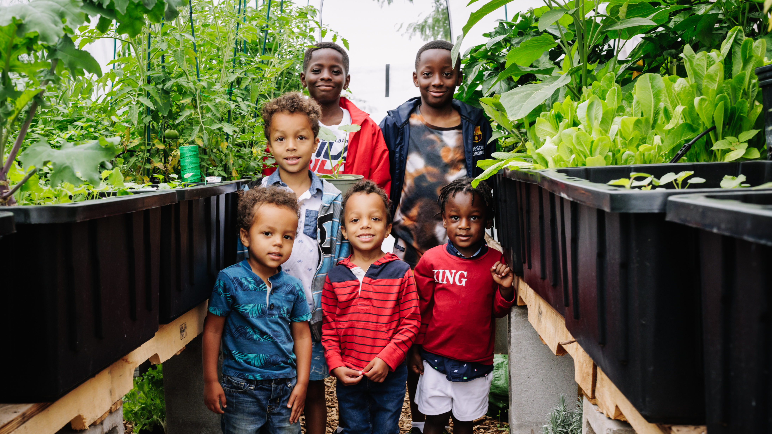
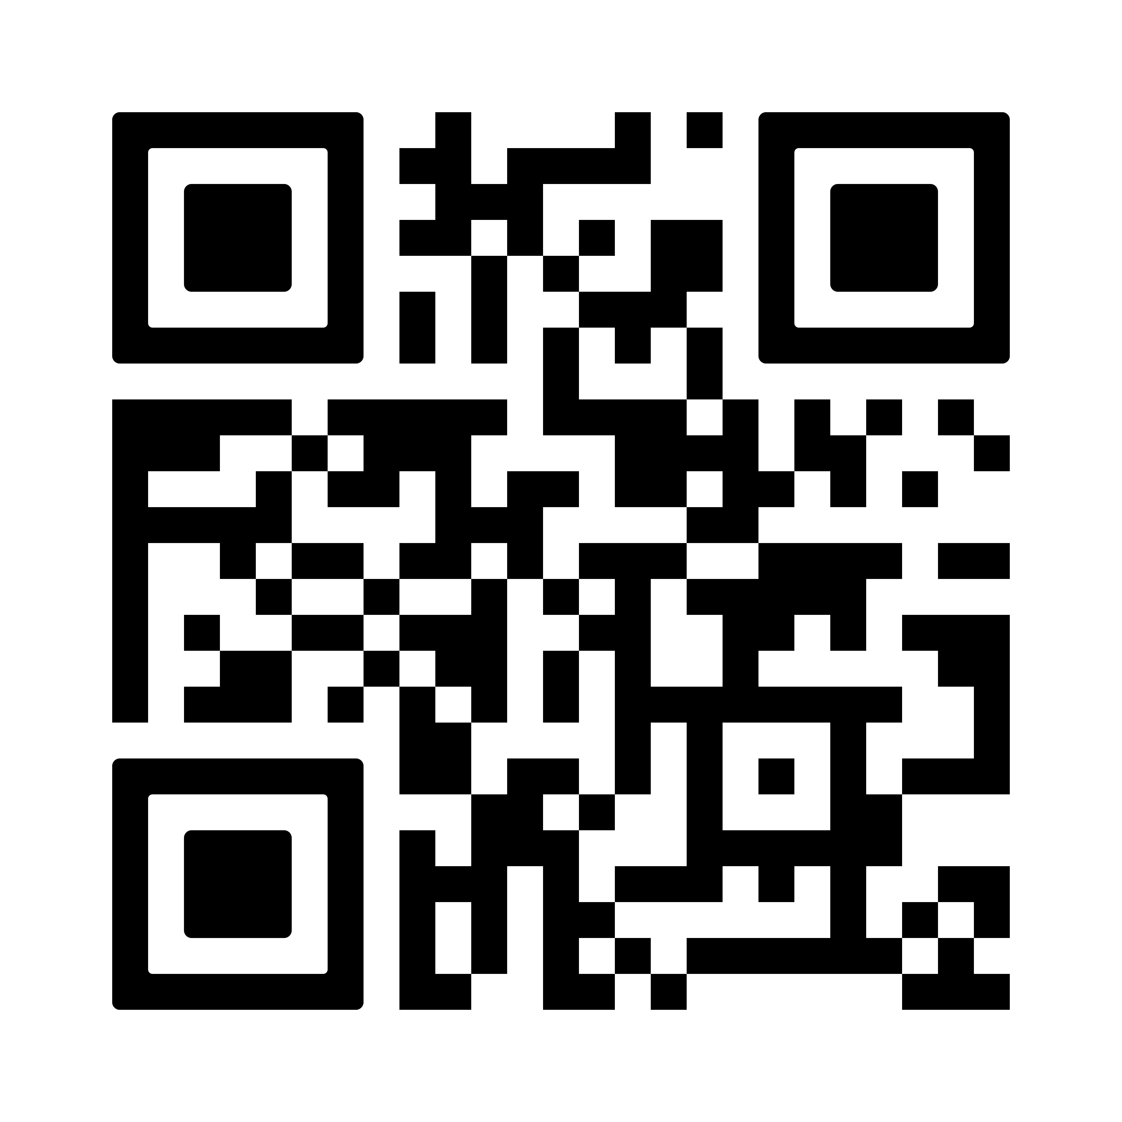
Even small gifts
add up to transformational
change
Give now at UnitedWayEM.ca
Notes:
Thanks to you, we are United. For our Community!
When we stand UNITED, we don't stand alone. We stand with tens of thousands of United Way supporters who believe that everyone needs help sometimes and everyone has the capacity to give help sometimes.
Even small gifts add up to transformational change.
Every donation matters—no matter the size.
Thanks to thousands of donors, including many who gave just $10 or $20, we make this incredible impact possible.
Feel free to use the QR code or visit UnitedWayEM.ca to give now, or participate through our workplace giving campaign.
10

