Slide 1
How to use this Presentation
Remember to hide or delete this slide before you present
This is intended to be a very high-level presentation that could be delivered in as little as
10 minutes.
Our suggested speaking remarks are in the “notes”.
There are many opportunities to tailor this presentation to suit your needs:
  Add your company logo in placeholders on slide 1
  Add your company’s 2026 fundraising results, logo and a team photo to slide 21
  Customize slide 22 to communicate your goal(s) and campaign initiatives
  Invite a guest speaker: United Way Philanthropy Officer, Sponsored Employee (5 min.)or agency impact speaker (book through United Way Elgin Middlesex)
  Slide 27 feel free to update with a QR Code to your custom UW workplace giving page
  We ask that you do not modify the United Way branding or logos.
For a shorter presentation, you can hide some of slides 8-20. We recommend keeping at least one of each colour.
Additional content can be found in the 2026 Campaign Key messages & playbook, accessible in the online Toolkit

Slide 2


[Insert your company logo here]
WORKING WITH LONDON,
ST. THOMAS AND COMMUNITIES
IN ELGIN & MIDDLESEX
Notes:
If in person: It's great to have you all here for our 2026 United Way Community Campaign! Thank you for your time today.
[Insert your own welcome to group, specific people in attendance & any people to introduce]
I am here to talk briefly about why we know Better is Possible, and what it means
Better housing is possible.
Better nutrition is possible.
Better mental health is possible..
When we work together to help give people a fair shot, a better community is possible.

Slide 3

Notes:
This short video introduces our Campaign theme for this year - Better is Possible!

Slide 4

Speaker name
Speaker title
[Insert your company logo here]
About
About
About
Notes:
Speaker details here

Slide 5

As of July, there are at least 1,621 individuals experiencing homelessness in London
1 in 5 children in our region are living in poverty
The Need
Notes:
Along with inflation, over the past few years food costs have increased by 27%.
This means families are spending more money to buy less.
And rising housing costs make the situation even more dire – for example rental prices have reached increased over 15% in just one year.
For many families, creates an impossible choice: pay the rent or put food on the table.
Nearly 40% of Canadians are now cutting back on groceries to afford other bills.
This economic stress is also taking a toll on mental health. People concerned about losing their homes are three times more likely to experience severe anxiety and depression.
The proportion of Canadians reporting difficulty meeting their financial needs has nearly doubled over the last two years to 33%.
That's why United Way is so important.

Slide 6

Last year, United Way invested $4 million into 39 agencies helping 158,000 people in
London, St. Thomas,
Elgin & Middlesex Counties.
Our impact
Notes:
United Way Elgin Middlesex prioritizes services that help reduce poverty and serve the populations most affected by social challenges in our region.
Core Messages
United Way Elgin Middlesex tackles poverty to give everyone a fair shot at a good life.
They prioritize housing stability, essential needs, and mental health supports.
These issues are all connected to each other, and all connected to poverty. To make the greatest impact, United Way supports local programs and public policies that focus on the individuals and communities who are most impacted.

Slide 7

Better is possible when we:
Ignite awareness about the issues our community is facing
Invest in local solutions that get results.
Mobilize community partners to do the most good for the most people.
Use our voice as a non-partisan advocate with all levels of government
Notes:
United Way is more than a funder, they advocate on issues that matter to you and your neighbours, and they mobilize community partners to do the most good for families, children, seniors, neighbours and friends.
All the funds raised stay right here in our area.
7

Slide 8
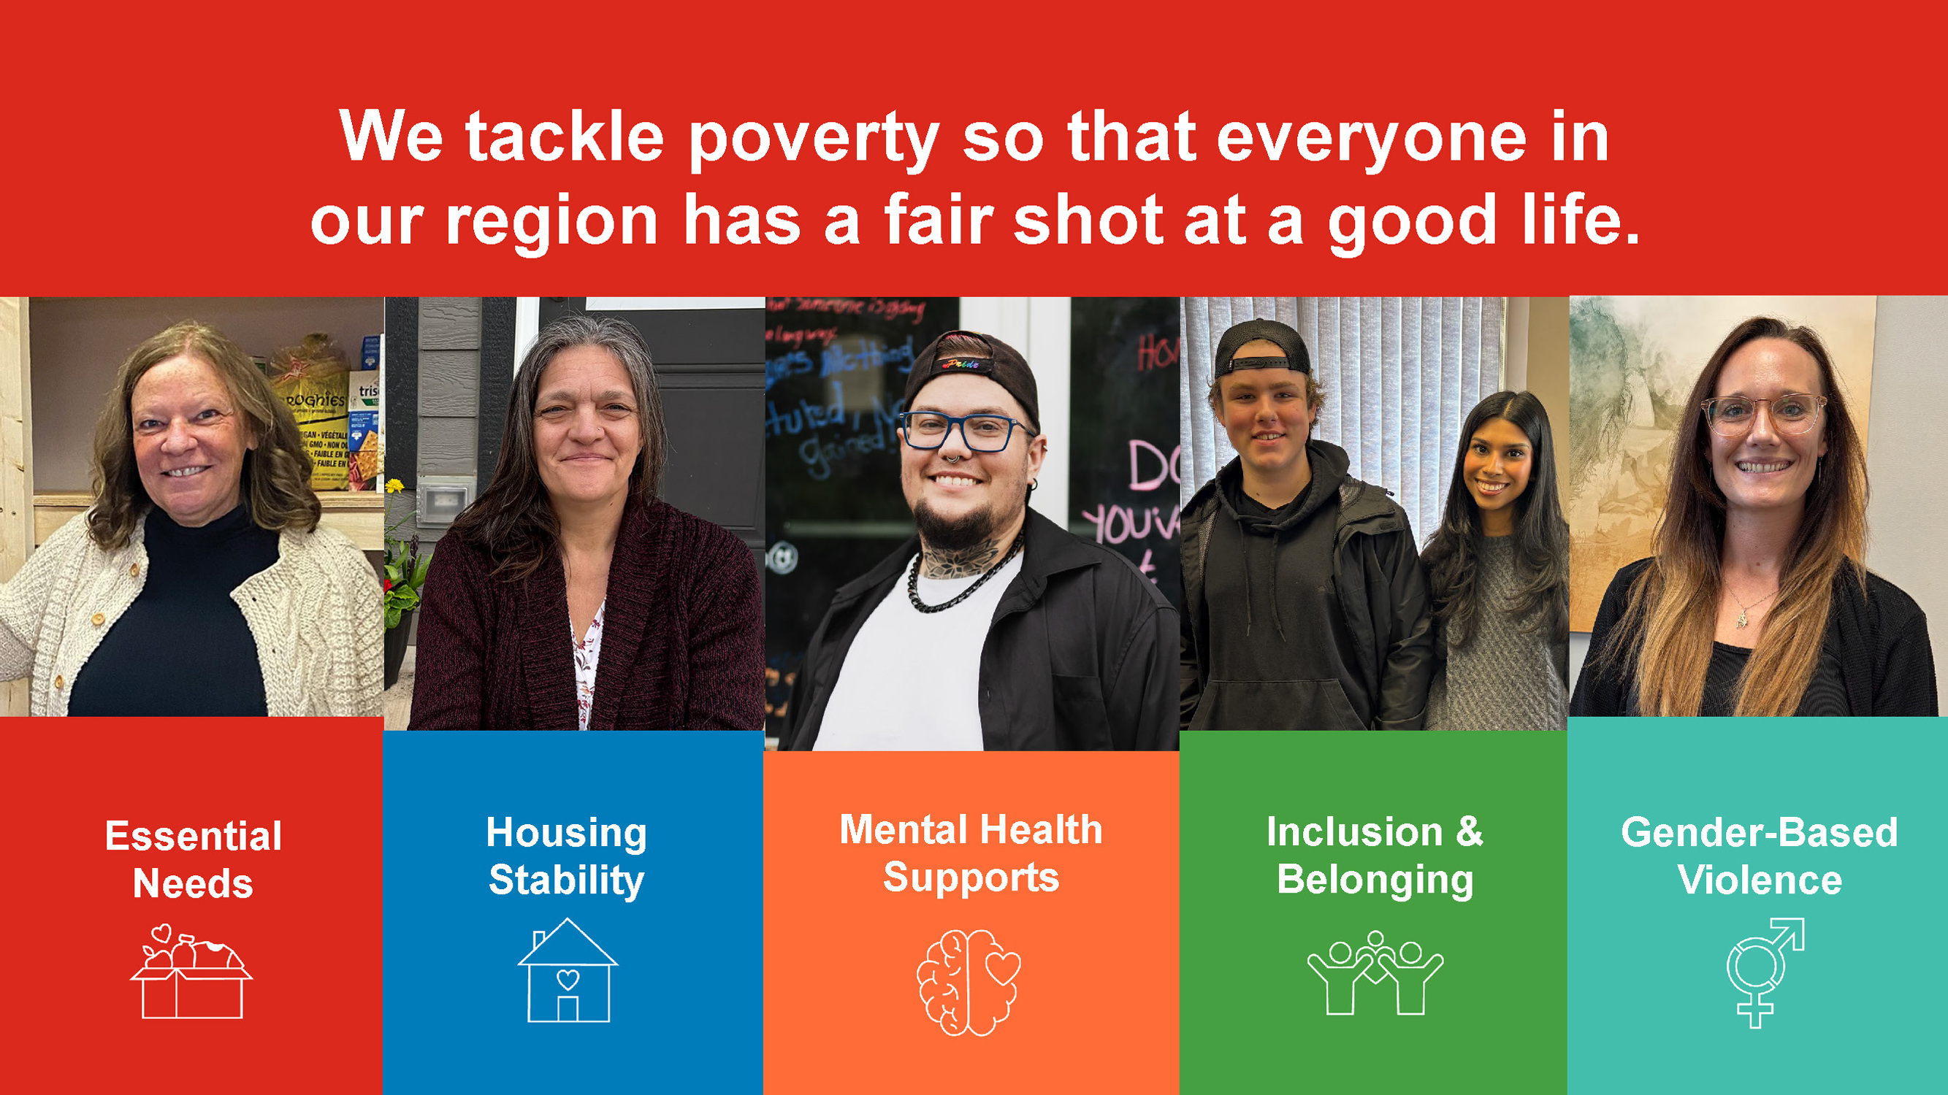
Essential
Nees
Notes:
Poverty looks different for everyone — but its impacts are felt across our entire community. Rising costs, limited access to housing and services, and systemic barriers continue to make it harder for people to meet their basic needs and live with dignity.
At United Way Elgin Middlesex, we tackle poverty so everyone in our region has a fair shot at a good life. Guided by our Community Impact volunteers, we focus our investments, advocacy, and partnerships in five priority areas that are all connected to poverty. We know by supporting these issues, we can create meaningful, lasting change.
Together with community partners, donors, and volunteers, we work to remove barriers, strengthen supports, and build better communites for everyone.

Slide 9
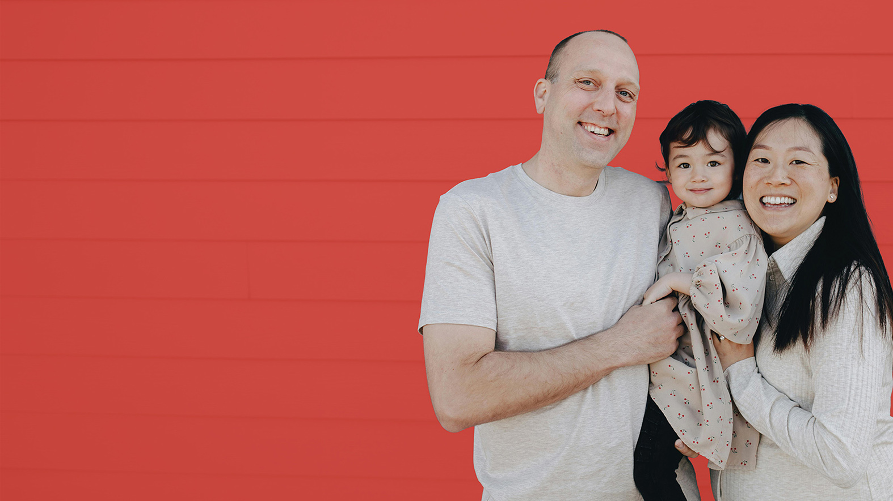
Essential Needs
Your support helps people access healthy food, clothing, toiletries, and transportation. Providing the resources they need today helps build the stability and confidence that open the door to new possibilities.
Notes:
Thousands of families need help accessing basic or essential needs. Programs that provide basic needs are also an important first contact for people to learn where they can get help for whatever issues they are facing.
9

Slide 10

“
It’s so nice to see them enjoying the food, getting to know each other and having
a good time here.
Krisstel, volunteer and part-time worker for the Essentials Services Program at the South London Neighbourhood Resource Centre
Notes:
10

Slide 11

Essential Needs
12,982 good food boxes were distributed to families
322,157 meals were served
44,083 snacks were served
Notes:
Food is a huge part of meeting essential needs, but toiletries, clothing and transportation are also key – especially for people exiting homelessness or trying to find employment.

Slide 12
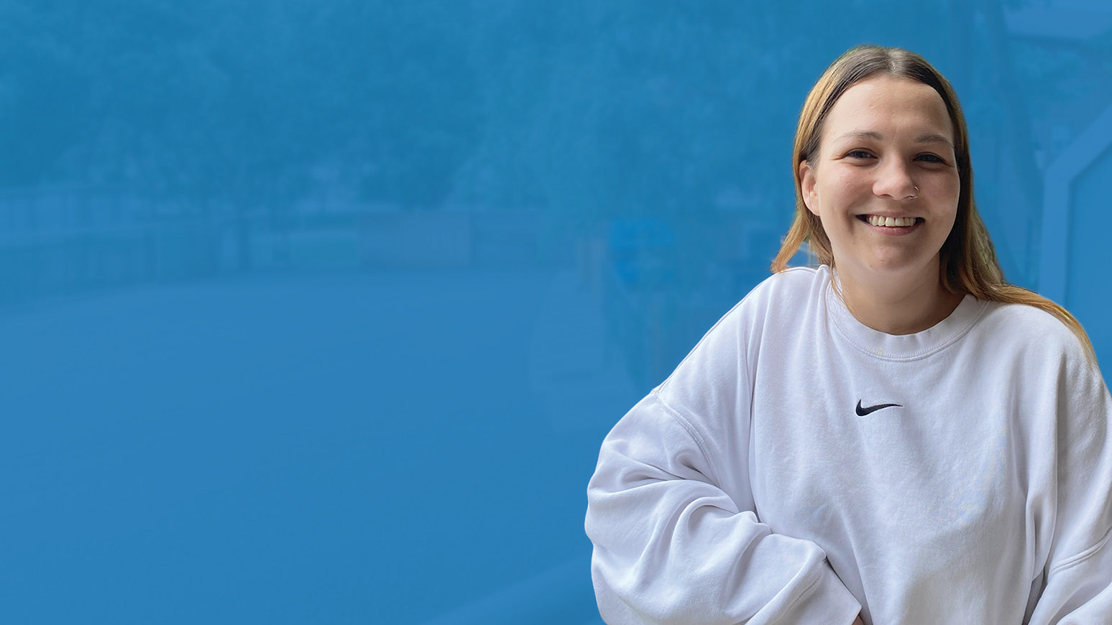
Housing Stability
Your support helps people find and keep safe housing. Doing so also strengthens mental health, employment, and family connections. We work to address emergency situations and to
advocate for long-term solutions.
Notes:
Without stable housing, it is nearly impossible to get or keep a job, to keep up with schoolwork, and to have a normal family life.
12

Slide 13

“
You need to be able to start building your life back again. Especially when you’ve lost everything you had before.
- Lynda, program participant at YWCA
St. Thomas-Elgin’s Housing Stability Program
Notes:
This Tiny Hope project in St Thomas is part of a dramatic turnaround in homelessness figures in that community. It is part of how we know Better is Possible!
13

Slide 14

Housing Stability
210 people moved into stable housing
344 more received support to maintain it
807 people are on the journey to get there

Slide 15

Inclusion & Belonging
By helping to create welcoming spaces and inclusive opportunities, we strengthen belonging for newcomers, Indigenous people, racialized communities, people with disabilities, rural residents, and others who face systemic inequity.
Notes:
We know that problems related to poverty can often pile up or snowball.
When people are able to access the help they need, we help prevent that snowball from gaining momentum.
15

Slide 16

“
We were worried, but with the support of LDALR programs,
it became such a positive experience for him.
- Tina, Logan’s mom, who is a program
participant at LDALR’s program:
"Right path. Right tools. Bright future.”
Notes:
The differences that make it harder for people to be fully part of community may not be obvious. One example is young people with learning disabilities. Through the Learning Disabilities Association of London and Area, we support both young people and their families, helping them learn to advocate for themselves.
16

Slide 17

Inclusion & Belonging
3,097+ youth participated in activities to promote healthy living and physical activity
1,669+ people built social connections and learned about local services

Slide 18

Gender-Based Violence
Your support helps ensure survivors of gender-based violence have access to trauma-informed, confidential, and appropriate services that prioritize safety, healing, and long-term recovery.
Notes:
We fund programs that help both the women affected by violence and their children, too. We also support an innovative program that works with abusive men, to help them break out of the cycle of violence.
18

Slide 19

Gender-Based Violence
505 individuals including 254 children got help healing from violent relationships

Slide 20

Mental Health Supports
Helping ensure individuals, families, and caregivers have access
to counselling, peer support, and other local resources that reduce stigma
and promote long-term well-being.
Notes:
In any given year, 1 in 5 Canadians will experience mental health issues. Rising economic stress in recent years contributes to this issue.
20

Slide 21

Mental Health Supports
2,199 people received free or subsidized counselling services
7,048 counselling sessions were provided
Notes:
Costs and waiting lists are significant barriers to getting support. By giving more people access to support when they need it, we can help prevent mental health issues from growing out of control and impacting people's housing, employment or education.

Slide 22
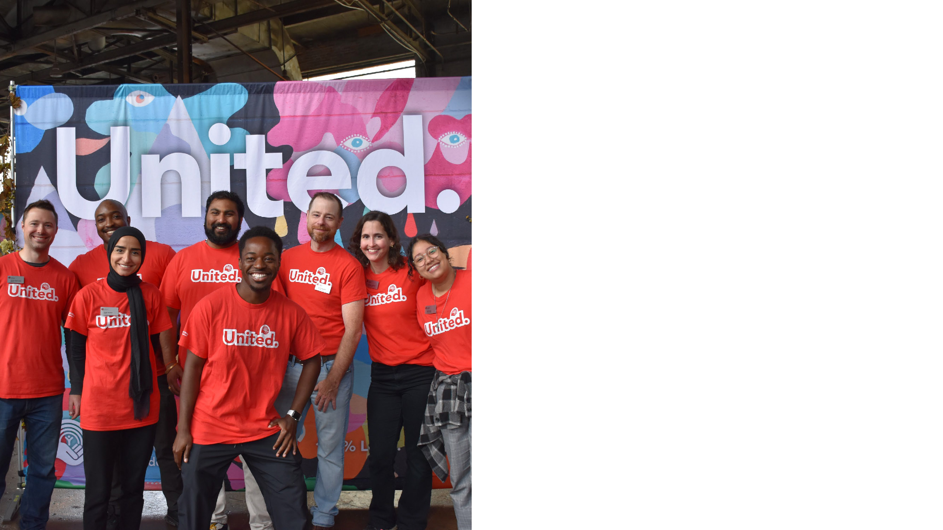
[Insert your company logo here]
We’ve helped support United Way Elgin Middlesex for X years
Last year we raised
$xx,xxx
Notes:
Last year, our [company name] campaign raised $xx,xxx in support of United Way Elgin Middlesex!
Thank you for participating in [list the various ways that your campaign raised funds - payroll giving, internal fundraising events, United Way events, etc.].
We have been supporting United Way for [X years] and in that time we've raised [Lifetime $amt]!
22

Slide 23

Easy ways to get involved!
Workplace Activity example one
Date
Workplace Activity example two
Date
Workplace Activity example three
Date
Notes:
[Use this slide if you are using text only]
This is a pivotal time for our community.
And this is a pivotal year for us to support United Way!
[If communicating a goal: Our goal is to exceed last year’s total and raise $_____].
There are many ways to participate in our internal campaign…..
[List dates – kick-off/wrap-up, internal fundraising activities etc]
23

Slide 24
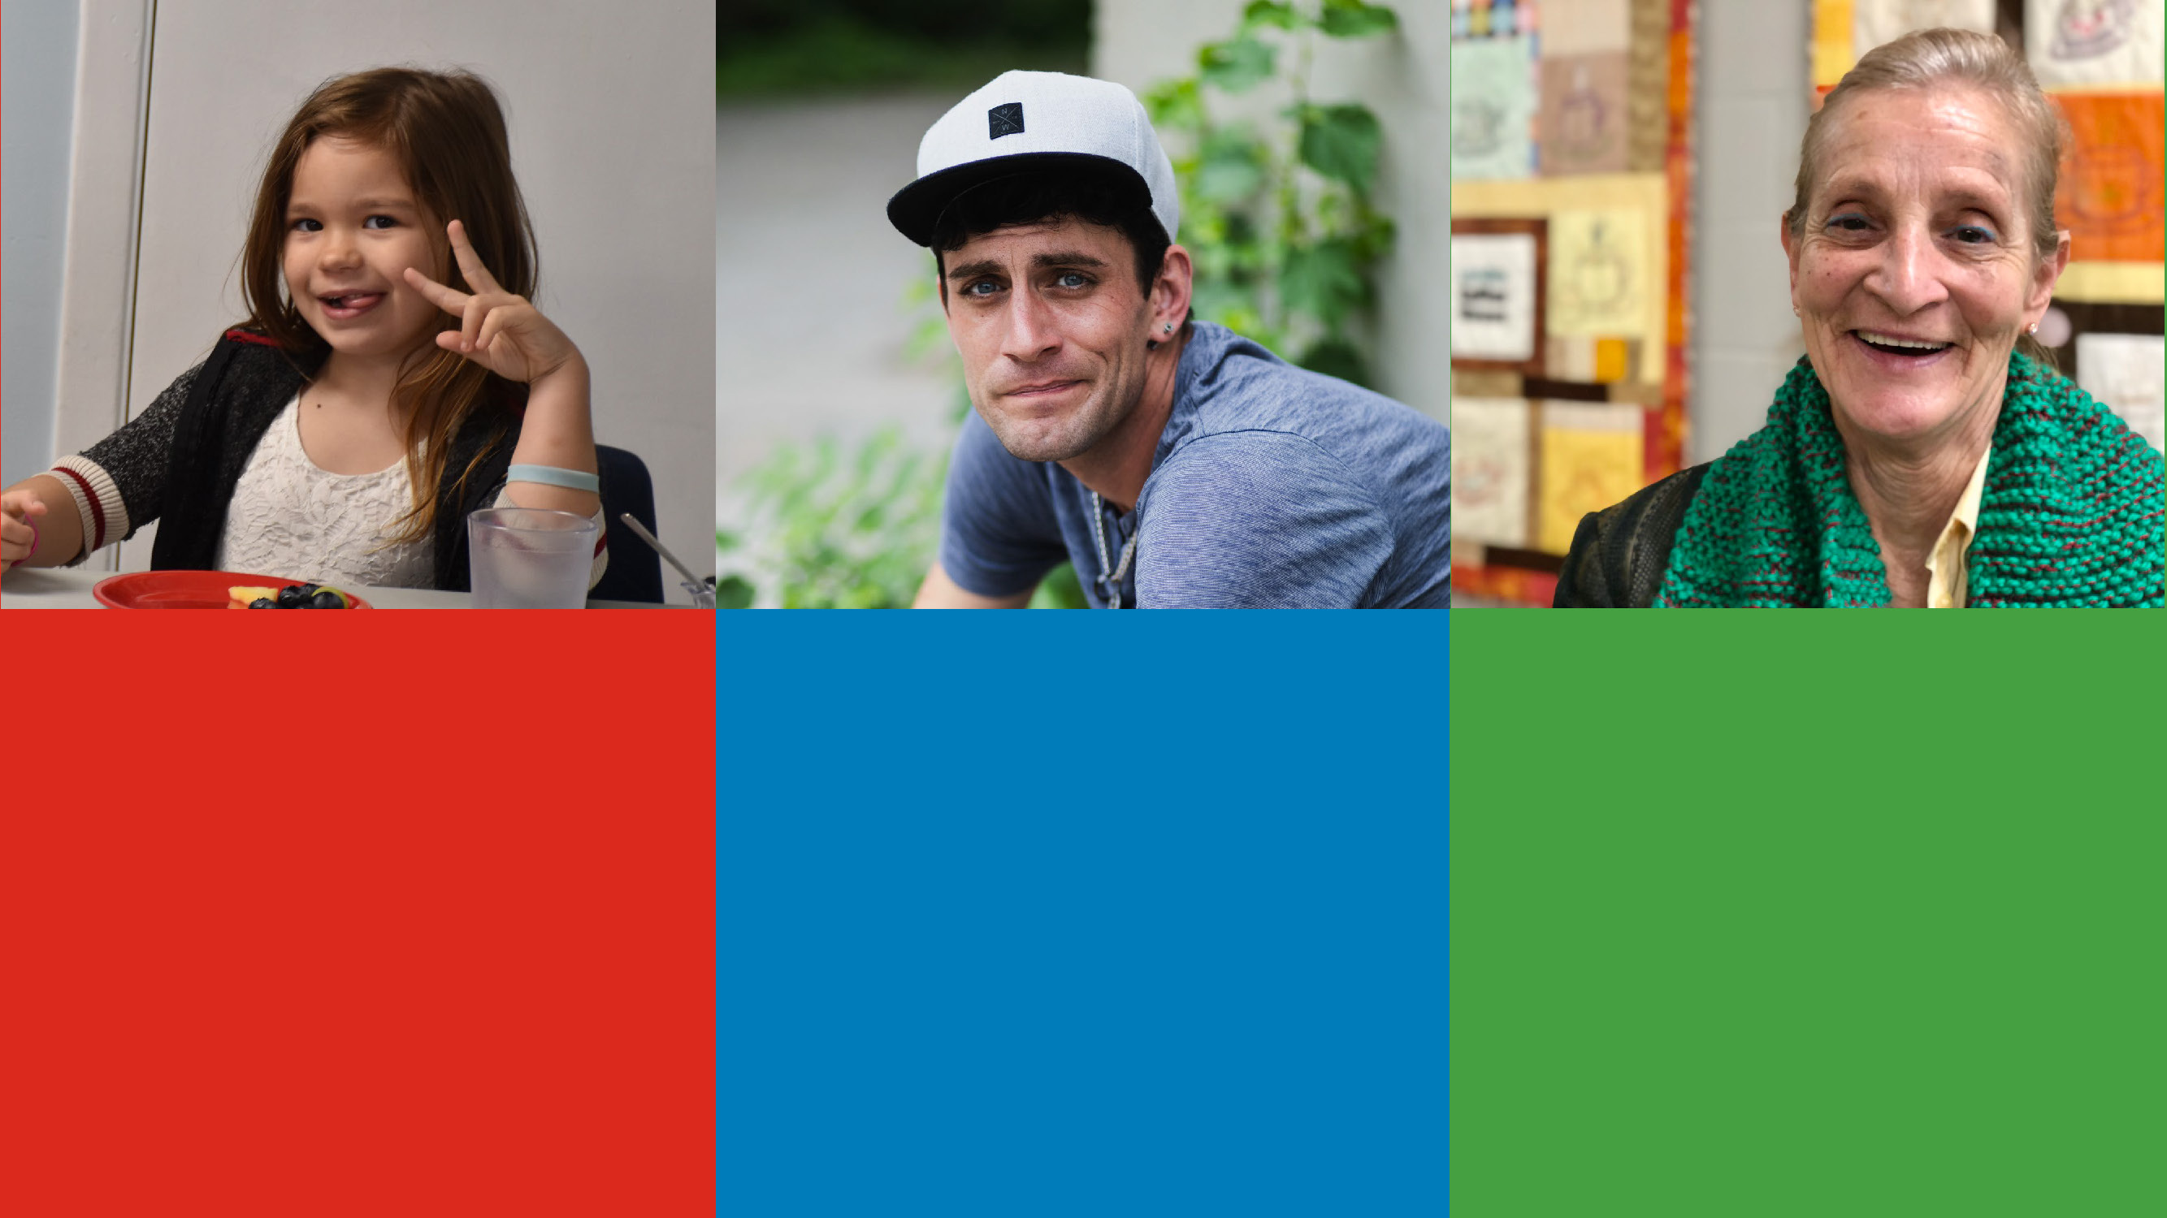
$1 / day
Provides 91 people with access
to fresh food through the
Northwest London Neighbourhood Resource Centre
$5 / pay
Provides someone in crisis
with an emergency counselling session through Family Services
Thames Valley
$100 / month
Provides medication support
for 40 people for a full month at
The INN in St. Thomas
Notes:
We also encourage you to donate through our employee payroll – it’s easy and is reflected on your T4.
If you are already giving though payroll contributions – thank you very much!
[This is a good opportunity to explain any early-bird incentive draws or corporate matching programs]

Slide 25


United Way Plane Pull
September 29
London International Airport
October 2
St. Thomas Municipal Airport
Teams of 10-15
Goal: Raise $1,500 per team
United Way Ultimate Burger Battle
November 1 – 30
Participating Restaurants
Try all the Ultimate Burgers and vote for your favourite!
$2 from each burger sold goes back
into the United Way Community Fund.
Plan ahead, great for team lunches!
Notes:
Join United Way this fall!
You can also get involved in United Way's own events:
September 29 – United Way Plane Pull - London
October 2 –United Way Plane Pull – St. Thomas
Month of November – Ultimate Burger Battle
25

Slide 26


Women supporting women
  Create change close to home by supporting initiatives that address urgent local needs.
  Build meaningful connections with like-minded women who care deeply about community.
  Lead with purpose by using your voice, skills, and resources to make a difference.
  Become a member at UnitedWayEM.ca
Notes:
New initiative! Women United
As new or longstanding leadership donor, there is a place for you in Women United.
Attending networking and learning events
Volunteering your time and talents
Sharing your passion and inviting others to join
New Women United event coming this February.
26

Slide 27
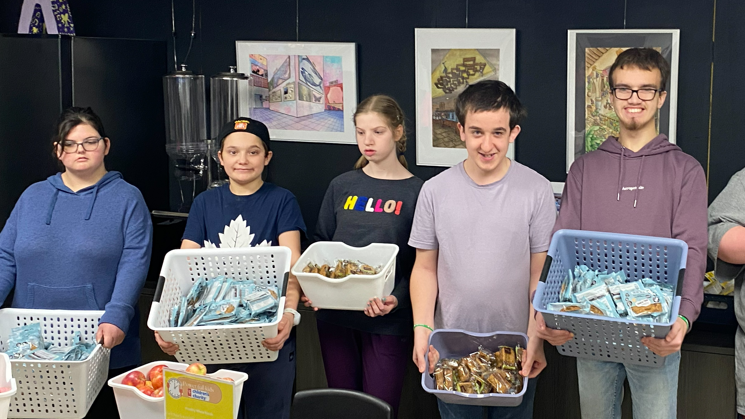

Even small gifts add up to transformational change.
Donate today!
Give now at UnitedWayEM.ca
Notes:
Thanks to you, we are creating a community where BETTER IS POSSIBLE.
Everyone needs help sometimes and everyone has the capacity to give help sometimes.
Even small gifts add up to transformational change.
Every donation matters—no matter the size.
Thanks to thousands of donors, including many who gave just $10 or $20, we make an impact on the lives of over 158,000 people.
Feel free to use the QR code or visit UnitedWayEM.ca to give or participate through our workplace giving campaign.
Together, United, Better IS possible.
27

